Slide 1


Session – 7
Displaying Graphics
& CSS3 Animation
Prepared by: Sir Muhammad Hamza
1

Slide 2
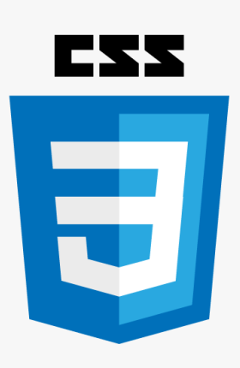
Objectives
Explain graphic formatting in Web pages
Explain Graphic insertion, Sizing, and Padding
Explain the CSS3 Animation
Describe the use of CSS3 on mobile devices
Prepared by: Sir Muhammad Hamza

Slide 3



Graphic Formats
There are three file formats for graphics used on the web: JPG, GIF, and PNG. Each of these file formats are designed with a specific purpose in mind, so it is important to understand the differences when we use them in our websites.
Prepared by: Sir Muhammad Hamza
3

Slide 4
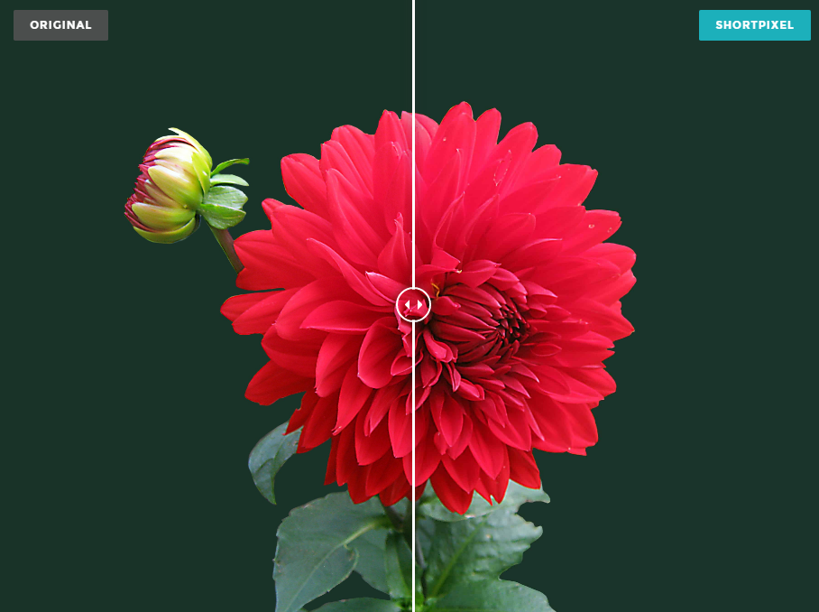
Compression \ File Size
Lossless:
Lossless compression means that as the file size is compressed, the picture quality remains the same.
Lossy:
The file can be decompressed to its original quality. Lossy compression permanently removes data.
Prepared by: Sir Muhammad Hamza
4

Slide 5
CSS Animation
An animation lets an element gradually change from one style to another.
You can change as many CSS properties you want, as many times as you want.
To use CSS animation, you must first specify some keyframes for the animation.
Keyframes hold what styles the element will have at certain times.
Prepared by: Sir Muhammad Hamza
5

Slide 6
CSS Animation
An animation lets an element gradually change from one style to another.
You can change as many CSS properties you want, as many times as you want.
To use CSS animation, you must first specify some keyframes for the animation.
Keyframes hold what styles the element will have at certain times.
Prepared by: Sir Muhammad Hamza
6

Slide 7
CSS Animation
An animation lets an element gradually change from one style to another.
You can change as many CSS properties you want, as many times as you want.
To use CSS animation, you must first specify some keyframes for the animation.
Keyframes hold what styles the element will have at certain times.
Prepared by: Sir Muhammad Hamza
7

Slide 8
CSS Animation
An animation lets an element gradually change from one style to another.
You can change as many CSS properties you want, as many times as you want.
To use CSS animation, you must first specify some keyframes for the animation.
Keyframes hold what styles the element will have at certain times.
Prepared by: Sir Muhammad Hamza
8

Slide 9
CSS Animation
An animation lets an element gradually change from one style to another.
You can change as many CSS properties you want, as many times as you want.
To use CSS animation, you must first specify some keyframes for the animation.
Keyframes hold what styles the element will have at certain times.
Prepared by: Sir Muhammad Hamza
9

Slide 10
Animation Properties
transition
transition-delay
transition-duration
transition-property
transition-timing-function
animation-name:
animation-duration:
animation-delay:
animation-iteration-count:
animation-direction:
Prepared by: Sir Muhammad Hamza
10

Slide 11
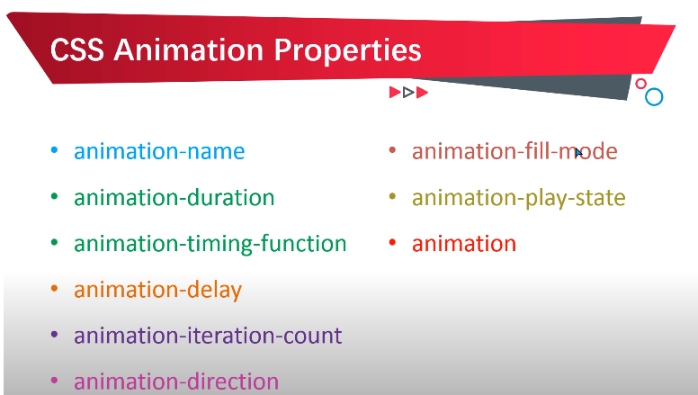
Prepared by: Sir Muhammad Hamza
11

Slide 12
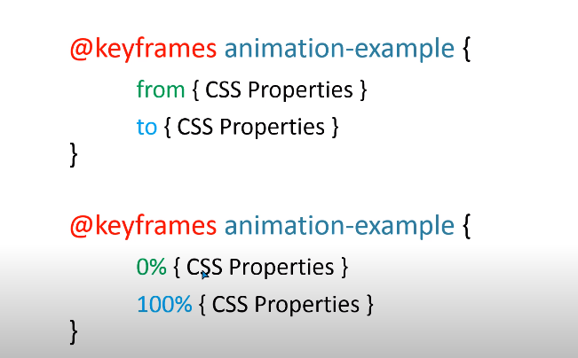
Prepared by: Sir Muhammad Hamza
12

Slide 13
@keyframes Rule
When you specify CSS styles inside the @keyframes rule, the animation will gradually change from the current style to the new style at certain times.
To get an animation to work, you must bind the animation to an element.
@keyframes example/AnyName { from {background-color: red;} to {background-color: yellow;} }
Prepared by: Sir Muhammad Hamza
13

Slide 14
Specify the Speed Curve of the Animation
The animation-timing-function property specifies the speed curve of the animation.
The animation-timing-function property can have the following values:
ease - Specifies an animation with a slow start, then fast, then end slowly (this is default)
linear - Specifies an animation with the same speed from start to end
ease-in - Specifies an animation with a slow start
ease-out - Specifies an animation with a slow end
ease-in-out - Specifies an animation with a slow start and end
#div1 {animation-timing-function: linear;}
#div2 {animation-timing-function: ease;}
#div3 {animation-timing-function: ease-in;}
#div4 {animation-timing-function: ease-out;}
#div5 {animation-timing-function: ease-in-out;}
Prepared by: Sir Muhammad Hamza
14

Slide 15

Transparency
The opacity property specifies the opacity/transparency of an element.
The opacity property can take a value from 0.0 - 1.0. The lower value, the more transparent:
0.2 0.5 1
Prepared by: Sir Muhammad Hamza
15

Slide 16
Introduction
Add Margins and padding
Prepared by: Sir Muhammad Hamza
16

Slide 17
CSS3 MEDIA QUERY
CSS media queries are a fundamental component of responsive web design. They allow you to apply different styles or rules to a web page based on the characteristics of the user's device or viewport, such as screen size, resolution, and orientation. Media queries enable your website to adapt and look good on various devices, including desktops, tablets, and smartphones.

Slide 18
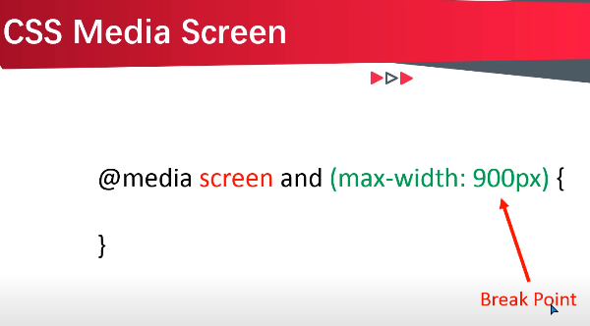
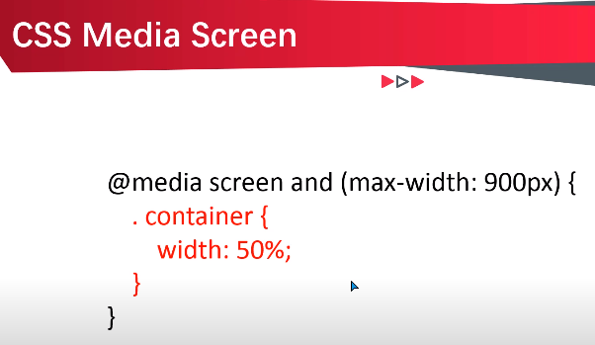

Slide 19
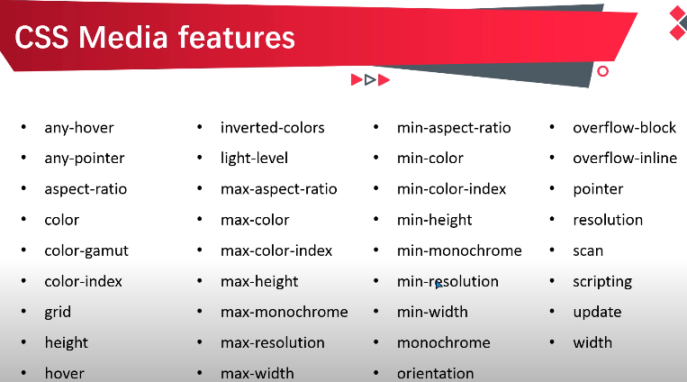

Slide 20
Introduction
After release of HTML5 and CSS3 in the market, Web designers have been developing graphics based Web pages.
CSS3 has allowed designers to style their Web pages graphically with ease.
Currently, HTML5 applications provide amazing experiences with the use of new CSS3 animations.
Introduction of mobile applications has allowed users to expand their Web usage to mobile devices.
CSS3 has introduced new features specifically for mobile devices.
Prepared by: Sir Muhammad Hamza
20

Slide 21
Introduction
CSS stands for Cascading Style Sheets
CSS is the language we use to style an HTML document.
CSS describes how HTML elements should be displayed.
It informs the browser how to present a document.
Prepared by: Sir Muhammad Hamza
21

Slide 22
CSS 3
Used for adding style such as fonts, colors and spacing to Web document
Has multiple levels and profiles.
Updates each level of CSS from the earlier version, by adding new features.
Denotes version as CSS1, CSS2, CSS3 and CSS4, where the numbers are different for each version or level.
Is divided into multiple documents called ‘modules’ and each of these modules have new capabilities or extend the features present in CSS2
Started drafting of CSS3 when publication of the original CSS2 recommendation was released.
Prepared by: Sir Muhammad Hamza
22

Slide 23
CSS Measurement Units [1-2]
The ABSOLUTE LENGTH units are fixed and a length expressed in any of these will appear as exactly that size.
Unit | Description
cm | Centimeters
mm | Millimeters
inch | inches (1 in = 96px =2.54cm)
px | pixels (1px = 1/96th of 1in)
pt | points (1pt = 1/72 of 1in)
pc | picas (1pc = 12 pt)
Prepared by: Sir Muhammad Hamza
23

Slide 24
CSS Measurement Units [2-2]
RELATIVE LENGTH units specify a length relative to another length property. Relative length units scales better between different rendering mediums.
Unit | Description
em | Relative to the font-size of the element (2em means 2 times the size of the current font)
vw | Relative to 1% of the width of the viewport*
vh | Relative to 1% of the height of the viewport*
% | Relative to the parent element
Prepared by: Sir Muhammad Hamza
24

Slide 25
Types of Style Sheets
CSS can be added to HTML documents in 3 ways:
Inline - by using the style attribute inside HTML elements
Internal - by using a <style> element in the <head> section
External - by using a <link> element to link to an external CSS file
The most common way to add CSS, is to keep the styles in external CSS files.
Prepared by: Sir Muhammad Hamza
25

Slide 26
Inline CSS
An inline CSS is used to apply a unique style to a single HTML element.
An inline CSS uses the style attribute of an HTML element.
The following example sets the text color of the <h1> element to blue, and the text color of the <p> element to red:
<h1 style="color:blue;">A Blue Heading</h1> <p style="color:red;">A red paragraph.</p>
Prepared by: Sir Muhammad Hamza
26

Slide 27
Internal CSS
An internal CSS is used to define a style for a single HTML page.
An internal CSS is defined in the <head> section of an HTML page, within a <style> element.
<!DOCTYPE html> <html> <head> <style> body {background-color: powderblue;} h1 {color: blue;} p {color: red;} </style> </head> <body> <h1>This is a heading</h1> <p>This is a paragraph.</p> </body> </html>
Prepared by: Sir Muhammad Hamza
27

Slide 28
An external style sheet is used to define the style for many HTML pages.
To use an external style sheet, add a link to it in the <head> section of each HTML page:
<!DOCTYPE html> <html> <head> <link rel="stylesheet" href="styles.css"> </head> <body> <h1>This is a heading</h1> <p>This is a paragraph.</p> </body> </html>
Prepared by: Sir Muhammad Hamza
28

Slide 29
CSS Selectors
CSS selectors are used to "find" (or select) the HTML elements you want to style.
We can divide CSS selectors into five categories:
Simple selectors (select elements based on name, id, class)
Combinator selectors (select elements based on a specific relationship between them)
Pseudo-class selectors (select elements based on a certain state)
Pseudo-elements selectors (select and style a part of an element)
Attribute selectors (select elements based on an attribute or attribute value)
Prepared by: Sir Muhammad Hamza
29

Slide 30
Element Selectors
The element selector selects HTML elements based on the element name.
Here, all <p> elements on the page will be center-aligned, with a red text color:
p { text-align: center; color: red; }
Prepared by: Sir Muhammad Hamza
30

Slide 31
ID Selectors
The id selector uses the id attribute of an HTML element to select a specific element.
The id of an element is unique within a page, so the id selector is used to select one unique element!
To select an element with a specific id, write a hash (#) character, followed by the id of the element
#para1 { text-align: center; color: red; }
Prepared by: Sir Muhammad Hamza
31

Slide 32
Class Selectors
The class selector selects HTML elements with a specific class attribute.
To select elements with a specific class, write a period (.) character, followed by the class name.
.center { text-align: center; color: red; }
Prepared by: Sir Muhammad Hamza
32

Slide 33
Universal Selectors
The universal selector (*) selects all HTML elements on the page.
The CSS rule below will affect every HTML element on the page:
* { text-align: center; color: blue; }
Prepared by: Sir Muhammad Hamza
33

Slide 34
Group Selectors
The grouping selector selects all the HTML elements with the same style definitions.
Look at the following CSS code (the h1, h2, and p elements have the same style definitions):
h1, h2, p { text-align: center; color: red; }
Prepared by: Sir Muhammad Hamza
34

Slide 35
CSS Combinator
Descendant Selector:
The descendant selector matches all elements that are descendants of a specified element.
The following example selects all <p> elements inside <div> elements:
div p { background-color: yellow; }
Visit for more
Child Selector (>):
The child selector selects all elements that are the children of a specified element.
The following example selects all <p> elements that are children of a <div> element:
div > p { background-color: yellow; }
Prepared by: Sir Muhammad Hamza
35

Slide 36
CSS Pseudo-classes
A pseudo-class is used to define a special state of an element.
For example, it can be used to:
Style an element when a user mouse over it
Style visited and unvisited links differently
Style an element when it gets focus
Syntax
selector:pseudo-class { property: value; }
Prepared by: Sir Muhammad Hamza
36

Slide 37
Anchor Pseudo-classes
Links can be displayed in different ways:
unvisited link: a:link { color: #FF0000; } visited link: a:visited { color: #00FF00; }
mouse over link: a:hover { color: #FF00FF; } selected link: a:active { color: #0000FF; }
Prepared by: Sir Muhammad Hamza
37

Slide 38
CSS Pseudo-Elements
CSS - The :first-child Pseudo-class:
A CSS pseudo-element is used to style specified parts of an element.
For example, it can be used to:
Style the first letter, or line, of an element
Insert content before, or after, the content of an element
Syntax
selector::pseudo-element { property: value; }
Prepared by: Sir Muhammad Hamza
38

Slide 39
CSS Pseudo-Elements
The ::first-line Pseudo-element:
The ::first-line pseudo-element is used to add a special style to the first line of a text.
The following example formats the first line of the text in all <p> elements:
Syntax
p::first-line { color: #ff0000; font-variant: small-caps; }
Prepared by: Sir Muhammad Hamza
39

Slide 40
CSS Pseudo-Elements
The ::first-letter Pseudo-element:
The ::first-letter pseudo-element is used to add a special style to the first letter of a text.
The following example formats the first letter of the text in all <p> elements:
Syntax
p::first-letter { color: #ff0000; font-size: xx-large; }
Prepared by: Sir Muhammad Hamza
40

Slide 41
CSS Attribute Selectors
CSS [attribute] Selector:
It is possible to style HTML elements that have specific attributes or attribute values.
The [attribute] selector is used to select elements with a specified attribute.
The following example selects all <a> elements with a target attribute:
Syntax
a[target] { background-color: yellow; }
Prepared by: Sir Muhammad Hamza
41

Slide 42
CSS Attribute Selectors
CSS [attribute="value"] Selector:
The [attribute="value"] selector is used to select elements with a specified attribute and value.
The following example selects all <a> elements with a target="_blank" attribute:
Syntax
a[target="_blank"] { background-color: yellow; }
Prepared by: Sir Muhammad Hamza
42

Slide 43
CSS Attribute Selectors
CSS [attribute~="value"] Selector:
The [attribute~="value"] selector is used to select elements with an attribute value containing a specified word.
The following example selects all elements with a title attribute that contains a space-separated list of words, one of which is "flower":
Syntax
[title~="flower"] { border: 5px solid yellow; }
Prepared by: Sir Muhammad Hamza
43

Slide 44
CSS Attribute Selectors
CSS [attribute|="value"] Selector:
The [attribute|="value"] selector is used to select elements with the specified attribute, whose value can be exactly the specified value, or the specified value followed by a hyphen (-).
Note: The value has to be a whole word, either alone, like class="top", or followed by a hyphen( - ), like class="top-text"
Syntax
[class|="top"] { background: yellow; }
Prepared by: Sir Muhammad Hamza
44

Slide 45
CSS Attribute Selectors
CSS [attribute^="value"] Selector:
The [attribute^="value"] selector is used to select elements with the specified attribute, whose value starts with the specified value.
The following example selects all elements with a class attribute value that starts with "top":
Syntax
[class^="top"] { background: yellow; }
Prepared by: Sir Muhammad Hamza
45

Slide 46
CSS Attribute Selectors
CSS [attribute*="value"] Selector:
The [attribute*="value"] selector is used to select elements whose attribute value contains a specified value.
The following example selects all elements with a class attribute value that contains "te“:
Syntax
[class*="te"] { background: yellow; }
Prepared by: Sir Muhammad Hamza
46

Slide 47
CSS Comments
CSS comments are not displayed in the browser, but they can help document your source code.
Comments are used to explain the code, and may help when you edit the source code at a later date.
Comments are ignored by browsers.
A CSS comment is placed inside the <style> element, and starts with /* and ends with */
Syntax
/* This is a comment */ p { color: red; }
Prepared by: Sir Muhammad Hamza
47

Slide 48
Summary
Prepared by: Sir Muhammad Hamza
48

Slide 49
Session-2 End
Thank You
Any Question?
Prepared by: Sir Muhammad Hamza
49

Slide 50
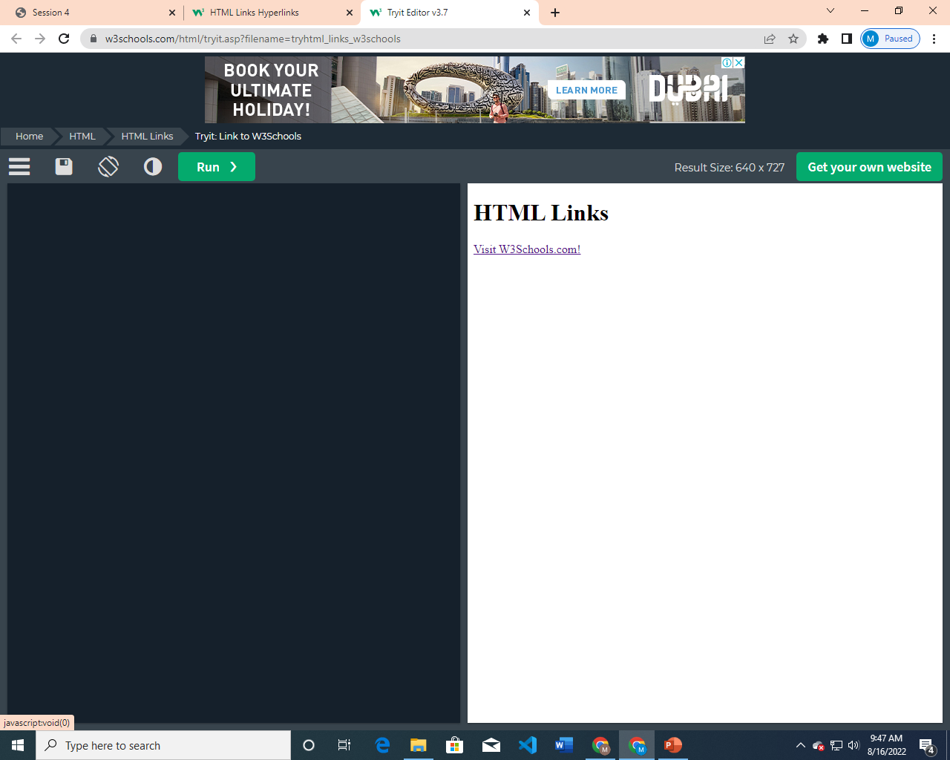
Hyperlinks [2-2]
<!DOCTYPE html>
<html>
<body>
<h1>HTML Links</h1>
<p><a href="https://www.w3schools.com/">Visit W3Schools.com!</a></p>
</body>
</html>
Prepared by: Sir Muhammad Hamza
50

Slide 51

Hyperlinks [2-2]
<!DOCTYPE html>
<html>
<body>
<p>To create a link that opens in the user's email program (to let them send a new email), use mailto: inside the href attribute:</p>
<p><a href="mailto:someone@example.com">Send email</a></p>
</body>
</html>
Prepared by: Sir Muhammad Hamza
51

Slide 52
Heading 1-2
Heading elements define headings for contents such as text and images.
Specifies the hierarchical structure of a Web page by grouping the contents.
Specifies the hierarchical structure of headings ranging from H1 to H6
H1 is the top level heading and is displayed with largest font size
H6 is the lowest-level heading and is displayed with smallest font size
Prepared by: Sir Muhammad Hamza
52

Slide 53
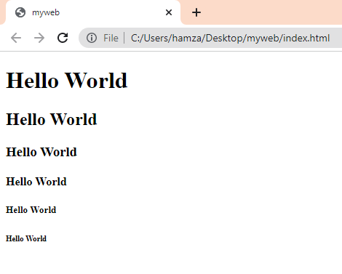
Heading 2-2
<!DOCTYPE html>
<html lang="en">
<head>
<title>myweb</title>
</head>
<body>
<h1>Hello World</h1>
<h2>Hello World</h2>
<h3>Hello World</h3>
<h4>Hello World</h4>
<h5>Hello World</h5>
<h6>Hello World</h6> </body>
</html>
Prepared by: Sir Muhammad Hamza
53

Slide 54
Basic Tags 2-9
HTML contains several elements for defining text with a special meaning.
Tag | Description
<b> | Bold text
<strong> | Important text
<i> | Italic text
<em> | Emphasized text
<mark> | Marked text
<small> | Smaller text
<del> | Deleted text
<ins> | Inserted text
<sub> | Subscript text
<sup> | Superscript text
Prepared by: Sir Muhammad Hamza
54

Slide 55
Element 2-2
Prepared by: Sir Muhammad Hamza
55

Slide 56
DOCTYPE
All HTML documents must start with a <!DOCTYPE> declaration.
The declaration is not an HTML tag. It is an "information" to the browser about what document type to expect.
In HTML5, the <!DOCTYPE> declaration is simple:
<!DOCTYPE html>
Prepared by: Sir Muhammad Hamza
56

Slide 57
Basic Tags 1-9
An HTML document is made up of different elements, tags, and attributes, which specify content and its format.
HTML is both a structural and presentational markup language.
Structural markup specifies structure of content, while presentational markup specifies format.
An HTML page is saved with . html extension.
Prepared by: Sir Muhammad Hamza
57

Slide 58
Basic Tags 2-9
Basic structure of an HTML document mainly consists of seven basic elements:
Tag Name | Tag
html | <html>
head | <head>
title | <title>
meta | <meta>
link | <link>
script | <script>
body | <body>
Prepared by: Sir Muhammad Hamza
58

Slide 59
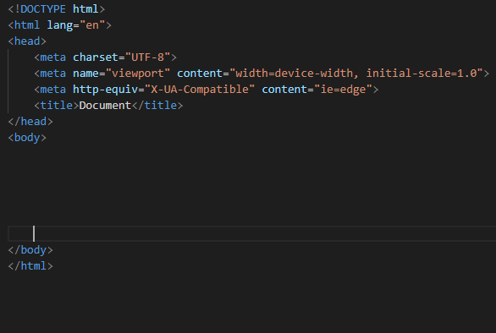
Basic Tags 3-9
HTML
START TAG
The html element is the root element that marks the beginning of an HTML document.
It contains start and end tag in the form of <html> and < /html> respectively. It is the largest container element as it contains various other elements.
End TAG
Prepared by: Sir Muhammad Hamza
59

Slide 60
Basic Tags 5-9
TITLE
The title element allows you to specify title of the Web page under <title> and </title> tags.
The title is displayed on the title bar of the Web browser. The title element is included within the head element.
START TAG / End TAG
Prepared by: Sir Muhammad Hamza
60

Slide 61
Basic Tags 6-9
META
SELF CLOSING TAG
The meta tag is used for displaying information about the data.
In HTML5, the content meta tag which was used for specifying the charset or character encoding has been simplified.
The new <meta> tag is as follows:
<meta charset="utf-8" />
UTF-8 is the most commonly used character coding that supports many alphabets. There are several other attributes associated with the meta tag that can be used to declare general information about the page.
This information is not displayed in the browser.
Meta tags provide search engines, browsers, and Web services with the information that is required to preview or acquire a summary of the relevant data of your document. A
Prepared by: Sir Muhammad Hamza
61

Slide 62
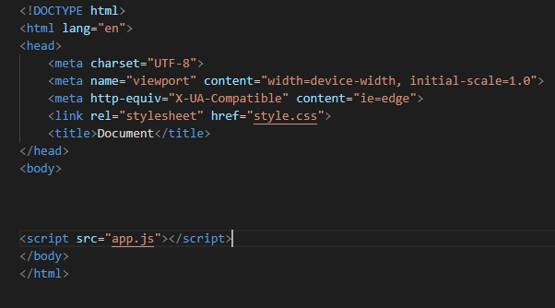
Basic Tags 7-9
LINK
The <link> tag is used to define the association between a document and an external resource.
It is used to link style sheets. Its type attribute is used to specify the type of link such as ‘text/css' which points out to a style sheet.
<link type="text/css" rel="stylesheet" href=“style.css">
The type attribute is not included in HTML5.
The reason is that CSS has been declared as the default and standard style for HTML5. So, the new link is as follows:
<link rel="stylesheet" href=“style.css">
SELF CLOSING TAG
Prepared by: Sir Muhammad Hamza
62

Slide 63
Basic Tags 8-9
SCRIPT
With HTML5, JavaScript is now the standard and default scripting language.
The type attribute tag can be removed from the script tags.
START TAG / End TAG
Prepared by: Sir Muhammad Hamza
63

Slide 64
Basic Tags 9-9
BODY
The body element enables you to add content on the Web page specified under the <body> and </body> tags.
Content can include text, hyperlinks, and images. You can display the content using various formatting options such as alignment, color, and background.
The following figure shows the basic HTML elements:
START TAG
End TAG
Prepared by: Sir Muhammad Hamza
64

Slide 65
Attributes
All HTML elements can have attributes
<p class=“foo”>This is paragraph</p>
Attribute
Attributes provide additional information about elements
Attributes are always specified in the start tag
Attributes usually come in name/value pairs like: name="value”
Prepared by: Sir Muhammad Hamza
65

Slide 66
Attributes
HTML attributes provide additional information about HTML elements
Attribute | Description
class | Multiple HTML elements can share the same class
Example | https://www.w3schools.com/html/html_classes.asp
id | The HTML id attribute is used to specify a unique id for an HTML element.
Example | <h1 id="myHeader">My Header</h1>
style | The style attribute is used to add styles to an element, such as color, font, size, and more.
Example | <p style="color:red;">This is a red paragraph.</p>
Prepared by: Sir Muhammad Hamza
66

Slide 67
Attributes
HTML attributes provide additional information about HTML elements
Attribute | Description
title | The information is most often shown as a tooltip text when the mouse moves over the element.
Example | <p><abbr title="World Health Organization">WHO</abbr> was founded in 1948.</p> <p title="Free Web tutorials">abc.com</p>
href | The <a> tag defines a hyperlink. The href attribute specifies the URL of the page the link goes to:
Example | <a href="https://www.w3schools.com">Visit W3Schools</a>
src | The <img> tag is used to embed an image in an HTML page. The src attribute specifies the path to the image to be displayed:
Example | <img src="img_girl.jpg">
Prepared by: Sir Muhammad Hamza
67

Slide 68
HTML Entities
Some characters are reserved in HTML.
If you use the less than (<) or greater than (>) signs in your text, the browser might mix them with tags.
Character entities are used to display reserved characters in HTML.
&entity_name;
OR
&#entity_number;
(To display a less than sign (<) we must write: &lt; or &#60;)
Prepared by: Sir Muhammad Hamza
68

Slide 69
HTML Entities
HTML attributes provide additional information about HTML elements
Result | Description | Entity Name | Entity No.
 | non-breaking space | &nbsp; | &#160;
< | less than | &lt; | &#60;
> | greater than | &gt; | &#62;
& | ampersand | &amp; | &#38;
" | double quotation mark | &quot; | &#34;
' | single quotation mark (apostrophe) | &apos; | &#39;
¢ | cent | &cent; | &#162;
£ | pound | &pound; | &#163;
© | copyright | &copy; | &#169;
Prepared by: Sir Muhammad Hamza
69

Slide 70
Container and Standalone Tags
There are two types of HTML elements namely, container and standalone elements.
A container element includes the start tag, contents, sub-elements, and end tag.
All the basic HTML elements are container elements.
A standalone element consists of the start tag and attributes followed by the end tag as /> without any content
Container Tags | Standalone Tags
<html></html> | <br/>
<body></body> | <hr/>
<h1></h1> | <img/>
<p></p> | <input/>
<script></script> | <link/>
<div></div> | <meta/>
Prepared by: Sir Muhammad Hamza
70

Slide 71
HTML5 and Mobile Devices
HTML5 helps to create better and richer mobile applications by using APIs that support advanced Web application features for mobile browsers.
New-age smartphones with Apple iOS and Google Android as operating systems support HTML5 compliant browsers.
HTML5 tries to integrate all the features to deploy mobile applications that would be compatible with all the platforms.
HTML5 provides features such as drag-and-drop functionality, video embedding in an application, and even offline capabilities.
As HTML5 is compatible with most mobile operating systems, up to 30% of the cost of development for different CPE rating systems is saved.
Also, there is a reduced dependency on third-party components, thus reducing the licensing costs.
All the required components will be readily available through the browser in HTML5.
Prepared by: Sir Muhammad Hamza
71

Slide 72
Benefits of HTML5 in Mobile Development
HTML5 has included APIs, hence additional plug-ins are not required for mobile browsers.
Mobile development is easier as knowledge of only HTML5, CSS, and JavaScript is majorly required.
There is a rising growth of HTML5 for mobile applications due to its enhanced compatibility.
HTML5 is compatible with most operating
The HTML5-based mobile applications can run on browsers of Android, 10S, Blackberry, Windows Phone, and other mobile operating systems.
The development cost for creating applications in HTML5 is low.
Applications based on location and maps will have greater support in HTML5.
Third-party programs are not required in HTML5.
Prepared by: Sir Muhammad Hamza
72

Slide 73
Prepared by: Sir Muhammad Hamza
73

Slide 74
Basic Tags
BODY
Prepared by: Sir Muhammad Hamza
74

Slide 75
Introduction
Proofing
Speech
Proofing
Speech
Prepared by: Sir Muhammad Hamza
75

Slide 76
Introduction
Prepared by: Sir Muhammad Hamza
76

Slide 77
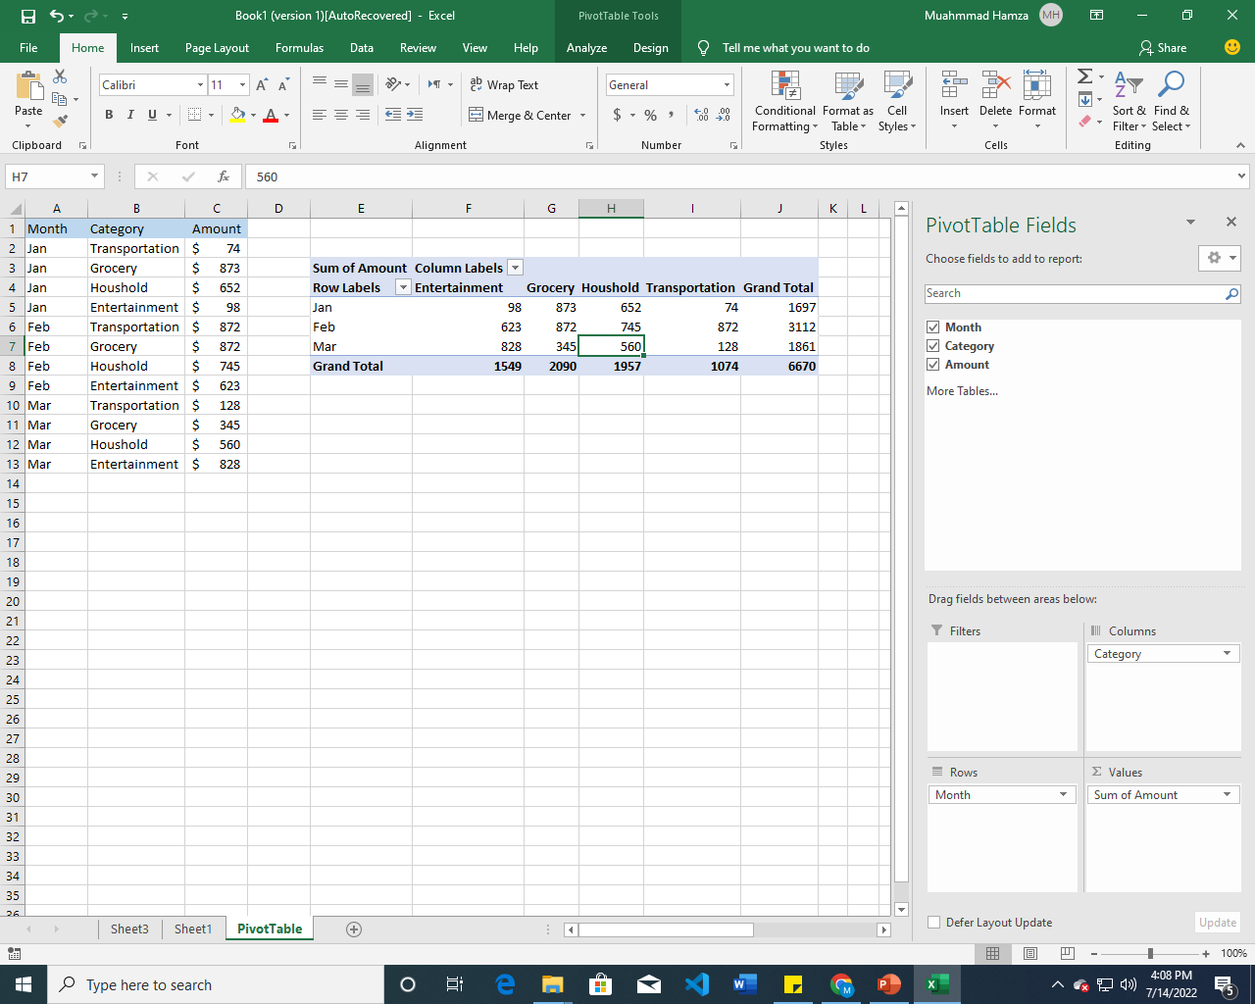
Understanding the Pivot Table
Explore the data
Change the form layout and field arrangement
Change the layout of columns, rows and subtotal
Change the display of blanks and error
Change the format

Slide 78
Changing the Form Layout and Field Arrangement [1-4]
Add, rearrange, and remove data fields
The Pivot Table form layout and field arrangement can be changed by doing the following
Change the table format form:
Compact, Outline, or Tabular
Change the order of fields or items

Slide 79
Changing the Form Layout and Field Arrangement [2-4]
Compact form
Displays items from different row area fields in one column. Also, it uses indentation to distinguish between the items from different fields. Row labels consume less space in Compact form, which leaves more space for numeric data.
Expand and Collapse buttons are displayed so you can show or hide the details in Compact form. The Compact table form as the name suggests saves space and makes the PivotTable more readable and is hence, specified as the default layout form for PivotTables.
Outline
form
Can display subtotals at the top of each group because items in the next column are displayed one level (row) below the current item.
Tabular form
Displays one column per field and provides room for field headers.

Slide 80
Changing the Form Layout and Field Arrangement [4-4]
Pivot Table and Pivot Chart Fields
Pivot Table | Description | Pivot Chart | Description
Values | Used to display summary numeric data | Values | Used to display summary numeric data
Row Labels | Used to display fields as row on the side of the report. A row lower in position is nested with another row immediately above it | Axis Field (Categories) | Used to display filed as an axis in the chart
Column Labels | Used to display fields as columns at the top of the report. A column lower in position is nested within another row immediately above it | Legend Fields (Series) | Used to display fields in the legend of the chart
Report Filter | Used to filter the entire report based on the selected item in the report filter | Report Filter | Used to filter the entire report based on the selected item in the report filter

Slide 81
Changing the Layout of Columns, Rows and Subtotals [1-2]
To further refine the layout of a PivotTable, the user can make changes that affect the layout of columns, rows, and subtotals, such as displaying subtotals above the rows or turning column headers OFF.
One can also rearrange individual items within a row or column.
The layout of columns, rows, and subtotals can be changed by doing the following:
Turn the column or row field heads ON or OFF or display or hide blank lines
Display subtotals above or below their row
Adjust column widths on refresh
Move a column field to the row area or a row filed to the column area
Merge or unmerge cells for outer row and column items

Slide 82
Change the Display of Blanks and Error
Hiding and Showing Field Headers
The display of blanks and errors can be changed by doing the following:
When a row in the PivotTable is selected, the PivotTable Tools tab gets displayed on the Ribbon. Blank rows can be inserted or removed from the Design tab in the Layout group.
Change how errors and empty cells are displayed
Change how items and labels without data are shown
Display or hide blank rows

Slide 83
Change the Format of the Pivot Table
Hiding and Showing Field Headers
One can choose from a wide variety of PivotTable styles in the gallery The user can control the banding (applying a shade) behavior of a report
The format of the PivotTable may be changed by doing the following:
Manually and conditionally format cells and ranges
Changing the overall PivotTable format style
Changing the number format for fields

Slide 84
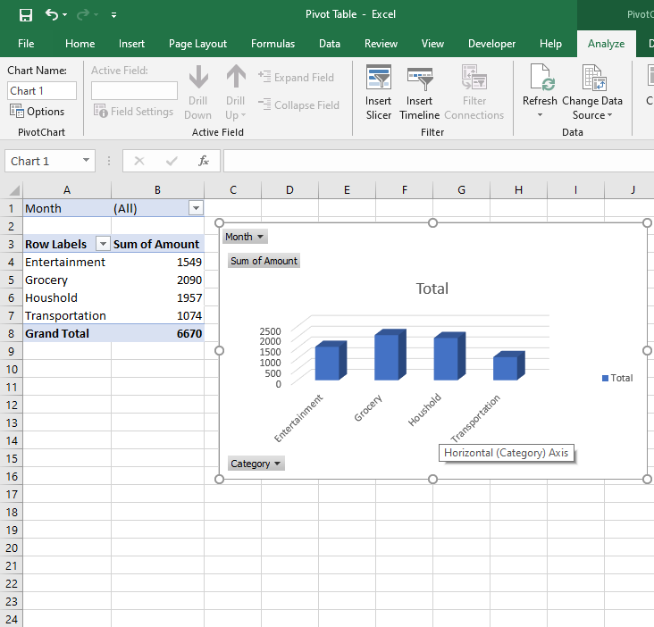
Understanding the Difference Between PivotChart and Standard
Creating a PivotChart with a PivotTable
Excel creates and inserts 3-D column
chart in the worksheet
Click anywhere in the PivotTable and then click Insert > PivotChart > PivotChart
There are various types of charts shown in the Insert Chart dialog box. Choose any one, such as 3-D column chart
PivotChart Created

Slide 85
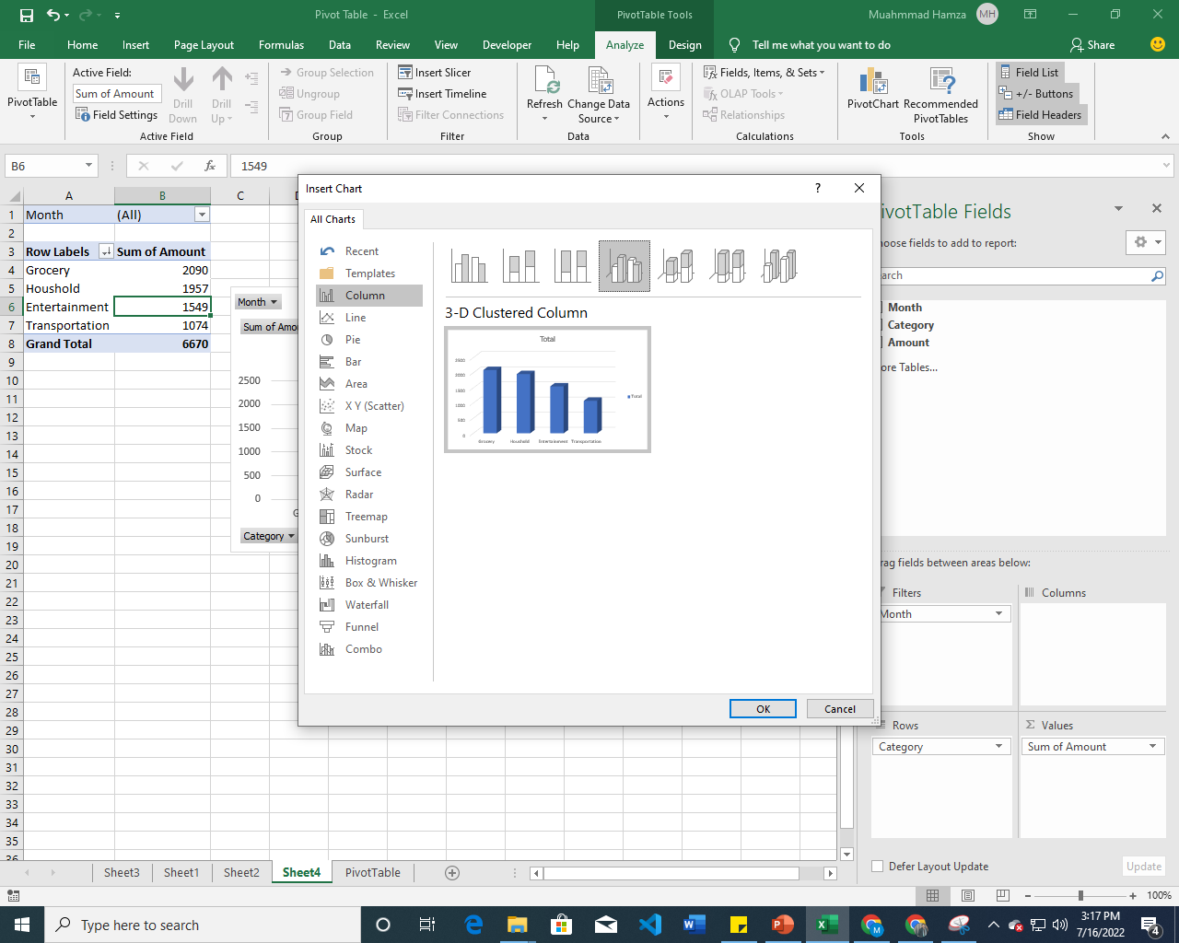
Available Chart Types in PivotChart
Column
Chart
Area
Chart
Line
Chart
XY (Scatter)
Chart
Pie and Doughnut
Chart
Stock
Chart
Bar
Chart
Surface
Chart
Radar
Chart
Combo
Chart

Slide 86
Power
Query [1-2]
Get data from a File such as an Excel workbook, Text or CSV file, XML and JSON files. One can also import multiple files from a given folder.
Get data from databases such as SQL Server, Microsoft Access, Analysis Services, SQL Server Analysis Server, and so on.
Get data from Microsoft Azure.
Get data from online services such as SharePoint, Microsoft Exchange, Dynamics 365, Facebook, and Salesforce.
Get data from other sources such as a table or range inside the current workbook, from the Web, a Microsoft Query, Hadoop, OData feed, ODBC, and OLEDB.
Merge two queries together similar to joining two queries in SQL.
Append a query to another query, similar to a union of two queries in SQL.

Slide 87
Types of User Management
The Query Editor Ribbon
Query List
Data Preview
Formula Bar
Properties
Applied Steps
Organizes data transformation commands and other power query options into five main tabs.
Lists all the queries in the current workbook. You can navigate to any query from this area to begin editing it.
Displays a preview of the data with all transformation steps currently applied.
Allows you to see and edit the M code of the current transformation step. Each transformation made on your data is recorded and appears as a step in the applied steps area.
Allows you to name your query. When you close and load the query to an Excel table, power query will create a table with the same name as its source query if the table name is not already taken.
Is a chronological list of all transformation steps that have been applied to the data. Move through the steps here and view the changes in the data preview area. You can also delete, modify, or reorder any steps in the query here.

Slide 88
Level of Protection
To control the level of access for users on an MS Excel file, file-level protection is used
If others should not be able to open the file
If other can Read-only or editing access to different users have to be restricted
The Excel file can be encrypted, which is the most common technique used. This means it is locked with a password and nobody except the team can open it.
If the managers in the team should have the access to edit the weekly status report, but team members should only have Read-only access, then the Excel file can be protected by specifying two passwords: one to open and the other to modify. This can later be shared appropriately with the team depending on the access they should be given.

Slide 89
Building Basic Formula [2-4]
Arithmetic Operators
Operator | Name
+ | Addition
- | Subtraction
/ | Division
* | Multiplication
% | Percentage
Comparison Operators
Operator | Name
= | Equal to
> | Greater than
< | Less than
>= | Greater than or Equal to
<= | Less than or Equal to

Slide 90
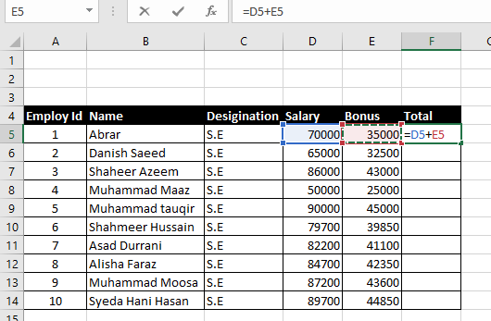
Building Basic Formula [4-4]
Reference Formulas Operators
Operator | Name
: (colon) | Range
(space) | Intersection
, (comma) | Union

Slide 91
New Functions in Excel 2019
Function | Example
IFS | =IFS(H2=5, "5000", H2=4, "3000",H2<4,"No Bonus")
MAXIFS | =MAXIFS(G2:G733,D2:D733,"Half-Time")
MINIFS | =MINIFS(G2:G733,D2:D733,"Half-Time")
SWITCH | =SWITCH(H2,5,"Good",4,"Fair",3,"Fair","?")
CONCAT | =CONCAT(C2,D2)

Slide 92
Summary
Excel formulas have the same basic structure: An 1=1 sign followed by one or more 'operands' which can be values, ranges, or cell references separated by one or more 'operators’.
Advanced formulas in Excel may involve converting text and validation of data, import and export data, and so on.
MS Excel includes many pre-defined functions that can be used to quickly find out the sum, average, count, maximum value, minimum value and so on, for a range of cells.
IFS, MAXIFS, MINIFS, SWITCH, and CONCAT are some of the newly introduced functions in Excel 2019.
Data validation is used to restrict the type of data or the values that the user enters into a cell.
You can insert icons and Scalable Vector Graphics (SVG) files and charts into your workbooks and manipulate them.
Excel supports several chart types including two new types, map charts and funnel charts.

Slide 93
MS Excel
Create, Find, and Share Excel Files
Share File
Create File
Find an Excel File

Slide 94



Formatting Excel Sheets [1-2]
When an Excel workbook is saved, it automatically gets saved in .xlsx format.
Excel 2019 supports saving in other formats, but whenever user saves a workbook in another file format, some of its formatting, data, and features might not be saved.
.docx
.xlsx
.pptx

Slide 95
Chart Types
Column
Scatter
New Chart Introduce
Line
Stock
Map
Funnel Chart
Pie
Surface
Allow users to compare values and show categories across geographical regions. They can be used when you have geographical regions in your data, such as countries/regions, states, and so on.
Show values across multiple stages in a process. For example, you could use a funnel chart to show the number of sales prospects at each stage in a sales pipeline.
Bar
Radar
Area
Combo Chart

Slide 96
Picture Format
Group
Adjust
3D Models
Picture Style
Size

Slide 97
Shapes Format
Group
Insert Shapes
Text
Shape Style
Arrange
WordArt Style
Size

Slide 98
Formatting Excel Sheets [2-2]
Excel Workbook
.xlsx
The default XML-based file format for Excel 2010 and Excel 2007. Cannot store Microsoft Visual Basic for Applications (VBA) macro code or Microsoft Office Excel 4.0 macro sheets (.xlm). Models
Excel Macro-Enabled Workbook (code)
.xlsm
The XML-based and macro-enabled file format for Excel 2016, Excel 2013, Excel 2010, and Excel 2007. Stores VBA macro code or Excel 4.0 macro sheets (.xlm)
Template
.xltx
The default file format for an Excel template for Excel 2010 and Excel 2007. Cannot store VBA macro code or Excel 4.0 macro sheets (.xlm).
Excel 97- Excel 2003 Workbook
.xls
The Excel 97 - Excel 2003 Binary file format (BIFF8)
XML Data
.xml
XML Data format

Slide 99
Data Analysis
MS Excel is a powerful tool that performs calculations, applies formulas, stores data, and also helps in analyzing the data.
Data Analysis helps in business planning and taking critical business decisions
Several methods can be used to analyze data. Few of these methods include:
Sort
Filter
Conditional Formatting
Chart
Pivot Table
What-if Analysis
Analysis ToolPak

Slide 100



What you learn in this Course?
Office 2019
You will learn in this course

Slide 101


MS Office 2019 for personal use
Office Home & Student 2019
Office Home & Business 2019
Office Home & Student
$89.99/One-time purchase
(for use on one computer)
$159.99/ One-time purchase
(for use on one computer)
$239.99/ One-time purchase
(for use on one computer)
All languages included and Compatible with Windows 10 and MacOS

Slide 102
Features in Windows 10
Question-1
Question-2
What is ZOOM in Power Point 2019?
What is Draw and Highlight in Office 2019?
Hint: I will be using these two tools/features to present to you in this session.

Slide 103
Why we use Windows 10?
Popularity
(According to Statcounter of May. 2022, Windows 10 is the most popular windows OS with about 75.54% market share in Desktop Operating System Worldwide.)
Price
Hardware and Software Compatibility
More Variety of Software
OS | Market share in %
Window | 75.54
MacOS | 14.98
Linux | 2.45
Chrome OS | 2.22

Slide 104
OS Market Share Pakistan
OS | Market share in %
Window | 82.39
MacOS | 3.3
Linux | 1.72
Chrome OS | 0.26

